Slide 1
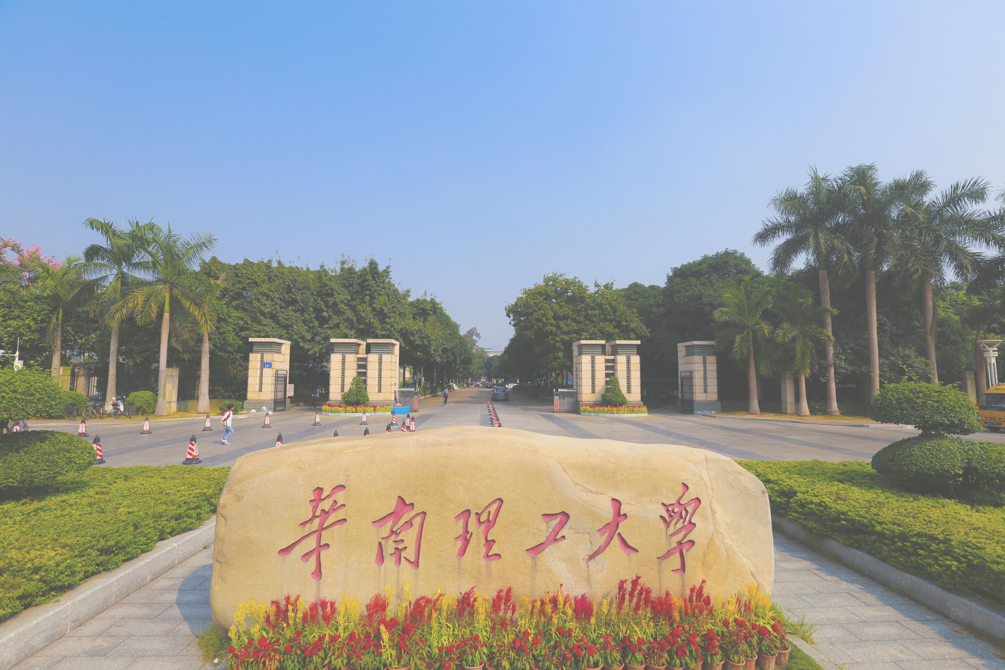
Monopoly
Group member:
谢东欣
黄嘉威
赵旻昆

Slide 2

01
Motivation & Introducion

Slide 3

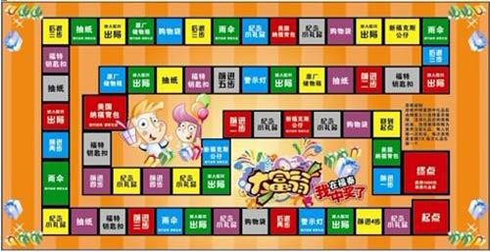
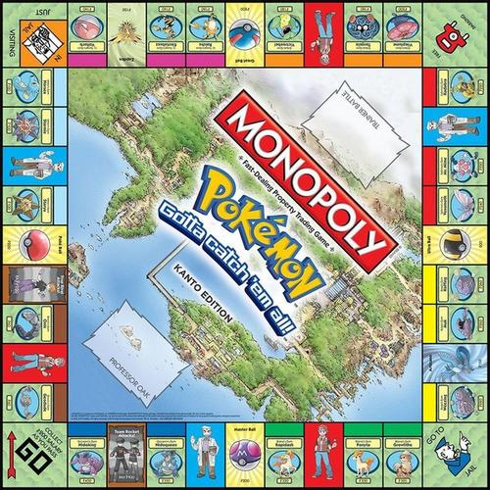
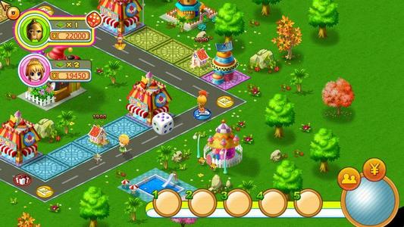
WARM UP

Slide 4
Background
Monopoly is a well-known board game which had the aim of exposing the capitalism’s harm originally. The participants who gain equal money at the beginning need to make good use of their fortune and transaction strategies to purchase lands and build buildings in order to acquire rents from other players. In addition, there will be only one winner at last while others all go bankrupt, as a consequence of which the name of this game is Monopoly.

Slide 5
Motivation
It is an appropriate choice to enhance our capability of problem analysis and programming skill since realizing it requires rigorous logical thinking and huge amounts of work.
We can also have a better understanding of object-oriented programming through doing this project due to the fact that it contains a variety of classes and inheritance relations etc.
Most people are familiar with this game as well as being fond of it, so that our project can draw people’s attention and gain their approval easily.
The topic also creates an opportunity for us to improve our innovative thinking ability. Because we can enrich our game’s functions and improve the practicality by standing on the players’ side since we already know the classical rules of the game.
There is no doubt that we students who major in computer science are always under great study pressure which does harm to our health and games like Monopoly can reduce our stress and bring happiness to us.

Slide 6
Our design of
Game’s Rules

Slide 7
The beginning of game
Each player has an asset of 1500 yuan or 15000 yuan originally.
The Decibels of Sound
We plan to use the decibels as the alternative of rolling the dice which contains six kinds of points to decide the number of each steps randomly.
Property
Once a player comes to an area which has no owner, he/she can decide whether to buy it or not. And if the player does not buy the area, the bank, which has infinite money, will sell it at auction immediately.
Houses and hotels
A player who is on the area he/she owns and has not been mortgaged can choose to build a house before any other players’ round. If the number of houses at one area reaches four, the play can choose to build a hotel. (One area can only contain one hotel at most.)

Slide 8
Cash withdrawal
Players can sell houses to the bank at the half price.
Transaction
Players can make a transaction with their opponents on the area where has no building at any time.
Jailed
Players cannot move but can still collect the rent, build houses and make transactions after being put in prison. Players can go out of the prison if they pay a fine of 50 yuan or they roll the same decibels of sounds.
Bankrupt
A player will go bankrupt when his/her money become negative even if he/she sells or mortgages all his/her property.
Success condition
The only player who has not gone bankrupt at last wins.

Slide 9
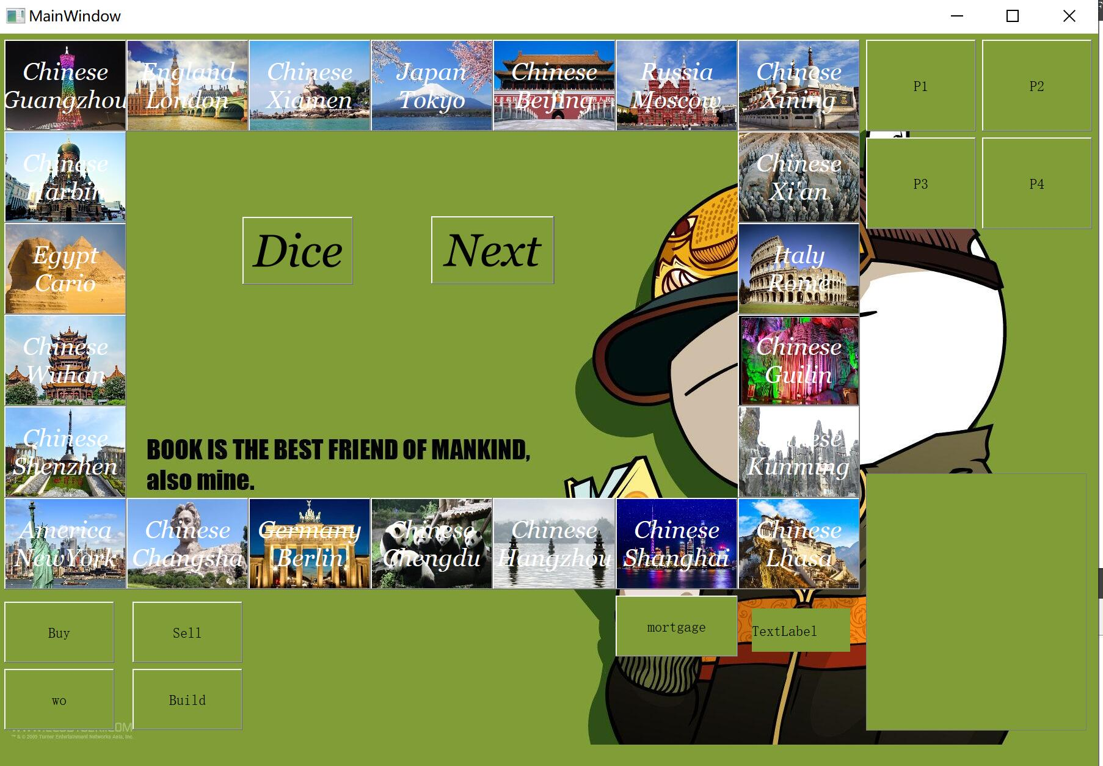
UI
谢东欣

Slide 10
QT
用Qtdesigner 可视化做UI界面，生成UI文件（其实就是xml）
对应一个gui，作为一个cpp类进行使用（这里就一堆继承关系了）
Qwidget-》Qmainwindow
| ——》Qdialog
根据玩家交互输入控制流，进入kernel的control类，返回数据，更新。

Slide 11
风格
无弹窗或者少弹窗
可全程鼠标操作
欢快的背景音乐（指欢乐斗地主
美工
城市背景图
可更换式游戏桌面
异形窗口

Slide 12
创新点（指新建文件夹
来自八分音符的灵感，用分贝啊，音高啊来控制步数再加上随机代替骰子。
如果时间足够，用分贝代替点数，然后检测音高的方差（记忆机制，按相差回合数加权），越小随机程度越大，鼓励玩家发出不同声音。
时间再够（如果colab微调得动的话。。），加入面部表情识别网络，笑得越开心点数越高（用概率来代替，所以拟合程度不能太高要微调）或者哭啊，生气啊之类的。（也不知道cpu跑得动不）

Slide 13
kernel and player
----by hjw

Slide 14
Menu
1.Control
2.MAP
3.Real player
4.Computer player

Slide 15
Control
player's operation
Account calculation
Turn change

Slide 16
MAP
Unit extend City
City's basic information
constructor to found different map(maybe)

Slide 17
Real player
Intex
Optoinal operation
Account

Slide 18
Computer player
greedy
Minimum guarantee
Adjustment

